Slide 1

Web APPLICATION Development (111834)
Dr. Owais Hussain

Slide 2

Agenda
Django Models and ORM
Creating a Model Class
Extending Existing Class
Audit Fields
DDL and Migrations
Django CLI

Slide 3
Sample 2
Django Models and ORM
Django model sits between RDBMS and Classes
Defined in models.py module
Each class extends base Model class, or a child of base Model class
The base Model class provides built-in methods: get, save, delete methods, as well as a few more
A typical class in Django is mapped to a Table in database
Class members/fields are mapped to columns in the database
Django supports a wide range of Databases out of the box

Slide 4
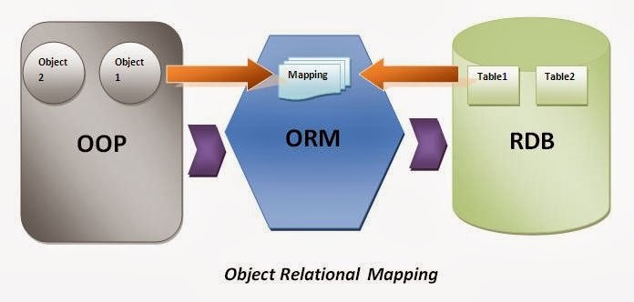
Sample 2
Django Models and ORM
Programming languages like OOP. Databases like SQL. ORM acts as a translator between the two.

Slide 5
Sample 2
Django Models and ORM
Field Types:
BooleanField: True/False
CharField, TextField: String based field
DateField, TimeField and DateTimeField: for Temporal data
DecimalField: Fixed precision Decimal numbers
FloatField: Floating precision Decimal numbers
IntegerField: 32-bit signed integer numbers

Slide 6
Sample 2
Django Models and ORM
Special Types:
AutoField: Integer field, which is automatically incremented. Used mostly as Primary Key
EmailField: Checks for a valid email address
FileField: Holds the path of a file (not the file itself)
ImageField: A FileField with additional validation that the input is an image
SlugField: A newspaper term, these can contain only containing only letters, numbers, underscores or hyphens. (URLs)
UUIDField: A universally unique, which stores in UUID datatype if the DB supports, otherwise stored in char(32) field.

Slide 7
Sample 2
Django Models and ORM
Relationship Types:
ForeignKey: typical Many-to-one relationship
ManyToMayField: (avoid)
OneToOneField: use when extending a row-to-row class, like User -> Person

Slide 8
Sample 2
Creating a Model Class
VehicleModel:
class VehicleModel(models.Model): make_id = models.AutoField(primary_key=True, db_column='id') # E.g. Toyota, Suzuki vendor = models.CharField(max_length=20, null=False, blank=False) # E.g. Vitz, Corolla, Swift model = models.CharField(max_length=20, null=False, blank=False, default='Unknown') # E.g. Hatch back, Sedan type = models.CharField(max_length=50, choices=[(t.name, t.value) for t in VehicleType], help_text="Select the vehicle chassis type") # Including the driver capacity = models.PositiveSmallIntegerField(null=False, default=2) class Meta: db_table = "baham_vehicle_model" def __str__(self): return f"{self.vendor} {self.model}"
Notes:
Note that there’s an Enumerated data type used for type. Next slide define what that is

Slide 9
Sample 2
Creating a Model Class
Create another file called enum_types.py and add the Enum:
class VehicleType(Enum): AUTO_RICKSHAW = "Auto Rickshaw" SEDAN = "Sedan" HATCHBACK = "Hatch Back" SUV = "Sub-Urban Vehicle" VAN = "Van" HIGH_ROOF = "High Roof" MOTORCYCLE = "Moto cycle/Scooter" def __str__(self): return self.value

Slide 10
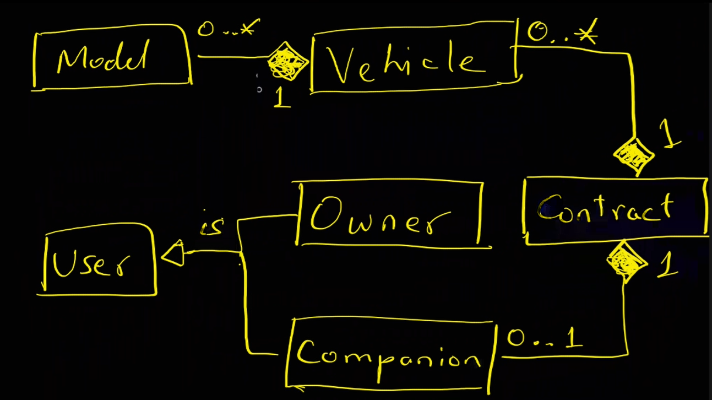
Sample 2
Creating a Model Class – Exercise
Complete the Model based on the Baham requirements

Slide 11
Sample 2
Creating a Model Class – Exercise
Vehicle class:
class Vehicle(models.Model): vehicle_id = models.AutoField(primary_key=True, db_column='id') registration_number = models.CharField(max_length=10, unique=True, null=False, blank=False, help_text="Unique registration/license plate no. of the vehicle.") color = models.CharField(max_length=50, default='white', validators=[validate_color]) model = models.ForeignKey(VehicleModel, null=False, on_delete=models.CASCADE) owner = models.ForeignKey(User, null=False, on_delete=models.CASCADE) date_added = models.DateField(models.DateTimeField(default=now, editable=False)) status = models.CharField(max_length=50, choices=[(t.name, t.value) for t in VehicleStatus]) def __str__(self): return f"{self.model.vendor} {self.model.model} {self.color}"

Slide 12
Sample 2
Extending an Existing Class
Why create another model from scratch for Users when a built-in one exists?
class UserProfile(models.Model):
user = models.OneToOneField(User, on_delete=models.CASCADE) # Should have one-to-one relationship with a Django user
birthdate = models.DateField()
gender = models.CharField(max_length=1, choices=[('M', 'Male'), ('F', 'Female')])
type = models.CharField(max_length=10, choices=[(t.name, t.value) for t in UserType])
primary_contact = models.CharField(max_length=20, null=False, blank=False)
address = models.CharField(max_length=255)
address_latitude, address_longitude = ?
landmark = models.CharField(max_length=255, null=False)
town = ?
bio = models.TextField()

Slide 13
Sample 2
Audit Fields
What is Audit?
When did it happen?
date_created, date_updated, date_voided
Who was responsible?
creator, updated_by, voided_by
What was previous state?
Versioning strategy
Keep last strategy
Soft deletion
voided (or is_active), void_reason
Universal Entity identification (UUID)
Why not Primary keys?

Slide 14
Sample 2
Audit Fields – Exercise
Add Audit fields to the model wherever applicable
Override the delete method and disable it for non-staff members

Slide 15
Sample 2
DDL and Migrations
We use version control to manage code changes. What about Database changes?
Why manage schema changes?
Consistent environment
Better testing
Data migrations
The Django Migration command:
python manage.py makemigrations
python manage.py migrate

Slide 16
Sample 2
Django CLI
The Command Line Interface provided by manage.py comes in handy for initial testing. Launch the shell using:
python manage.py shell
>>from django.db import models
>>from django.contrib.auth.models import User
>> user = User.objects.create_user(username='owais.hussain', email=owais.hussain@kiet.edu.pk', password='AR3@lly$tr0ngPasswD’)
>> owais = User.objects.get(username='owais.hussain’)
Try out shell commands to Create, Update, Delete, Get objects from your custom model entities.

Slide 17



THANK YOU
Owais Hussain
+92 345-3174270
owais.hussain@kiet.edu.pk
https://www.researchgate.net/profile/Owais-Hussain-3

